Slide 1
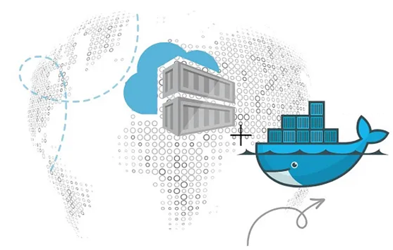
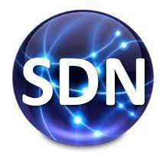
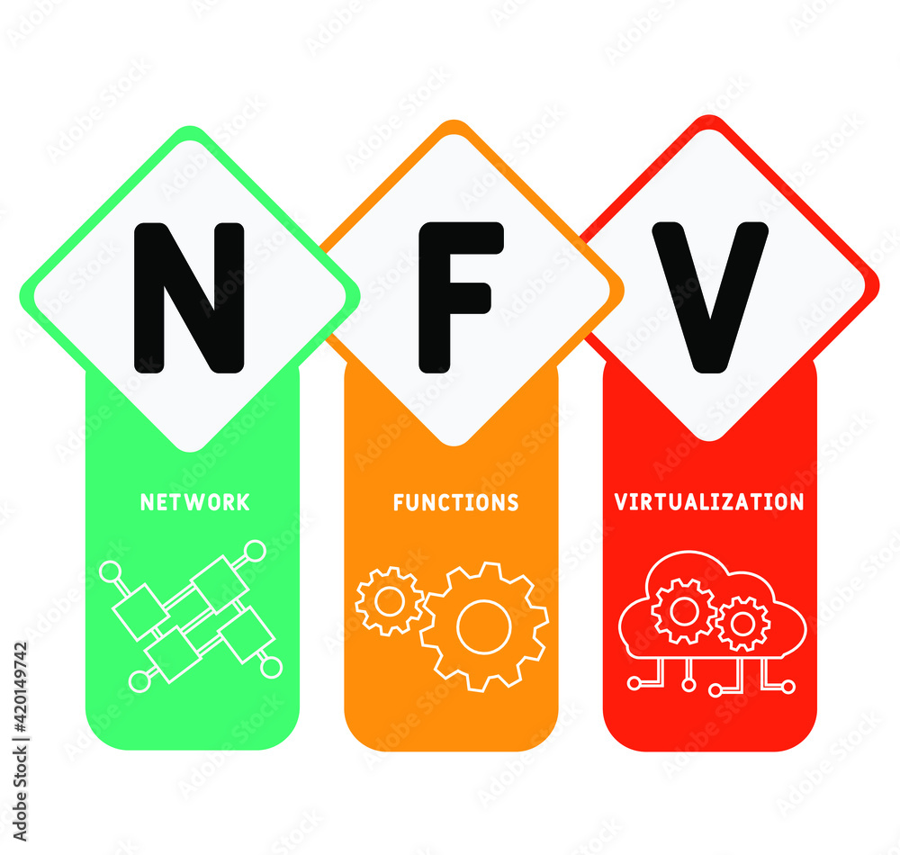
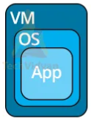
PDS
Computer Vision
XIII Docker Kubernetes : Cloud Infrastructure
https://github.com/siagianp
https://www.youtube.com/@AmelOline/videos
Open TofU-IaC
https://github.com/amelcharolinesgn2/IoT_simulator-mqtt-NodeRed
https://github.com/amelcharolinesgn2/Cloud-Infrastructures
Notes:
Lab https://dockerlabs.collabnix.com//beginners/dockerfile/lab4_dockerfile_copy.html
https://dockerlabs.collabnix.com/?_gl=1*xgt5mz*_ga*MTk0NzgyNDQ5OC4xNzU2Mjg2NDY5*_ga_2YBFHJ8C2X*czE3NTYzNjY4ODIkbzIkZzAkdDE3NTYzNjY4ODIkajYwJGwwJGgw
https://roadmap.sh/aws
https://roadmap.sh/aws
https://aws.amazon.com/what-is-cloud-computing/
https://www.ibm.com/think/topics/cloud-computing
3. https://www.ibm.com/topics/cloud-computing
4. https://csrc.nist.gov/pubs/sp/800/145/final
https://csrc.nist.gov/pubs/sp/800/145/final
https://docs.openstack.org/liberty/install-guide-rdo/overview.html

Slide 2
Setting Up Kubernetes on Cloud Platforms
Prerequisites
Before setting up a Kubernetes cluster, ensure you have the following:
Google Cloud Account: Sign in to your Google Cloud account or create one if you’re new to Google Cloud.
Billing Enabled: Ensure billing is enabled for your Google Cloud project.
APIs Enabled: Enable the Artifact Registry and Google Kubernetes Engine APIs.
Cloud Shell: Launch Cloud Shell, which comes preinstalled with the Google Cloud CLI and kubectl command-line tools.
Set Default Project:
gcloud config set project PROJECT_ID
Create a GKE Cluster:
gcloud container clusters create sample-cluster --zone us-central1-a
Deploying an Application to the Cluster
Create the Deployment:
kubectl create deployment hello-server --image=us-docker.pkg.dev/google-samples/containers/gke/hello-app:1.0
Creates a Deployment named hello-server using the specified container image.
Expose the Deployment:
kubectl expose deployment hello-server --type LoadBalancer --port 80 --target-port 808
Deployment to the internet using a LoadBalancer Service, routing traffic from port 80 to port 8080 of the application
Notes:
https://medium.com/@platform.engineers/setting-up-kubernetes-on-cloud-platforms-2dde3c20af18
https://blog.devops.dev/kubernetes-architecture-understanding-nodes-and-processes-bcc0e860a012

Slide 3
Setting Up Kubernetes on Cloud Platforms
Understanding Kubernetes Components
Deployment: A Kubernetes Deployment manages stateless applications like web servers. It ensures that a specified number of replicas (Pods) are running at any given time.
Service: A Kubernetes Service provides a network identity and load balancing for accessing your application from the internet. In this case, a LoadBalancer Service is used to expose the Deployment.
Using Cloud Shell for Cluster Management
Cloud Shell is a convenient way to manage your GKE cluster using gcloud and kubectl commands. Here’s how you can use it:
Launch Cloud Shell: Go to the Google Cloud console and click the Activate Cloud Shell button in the upper-right corner. This opens a Cloud Shell session where you can run commands.
Run Commands:
gcloud container clusters list kubectl get deployments kubectl get services
CLI Tools for Cloud Providers
GKE:
gcloud container clusters create sample-cluster gcloud container clusters list gcloud container clusters delete sample-cluster
AKS:
az aks create -g MyResourceGroup -n MyManagedCluster az aks list az aks delete -g MyResourceGroup -n MyManagedCluster
Notes:
https://medium.com/@platform.engineers/setting-up-kubernetes-on-cloud-platforms-2dde3c20af18

Slide 5
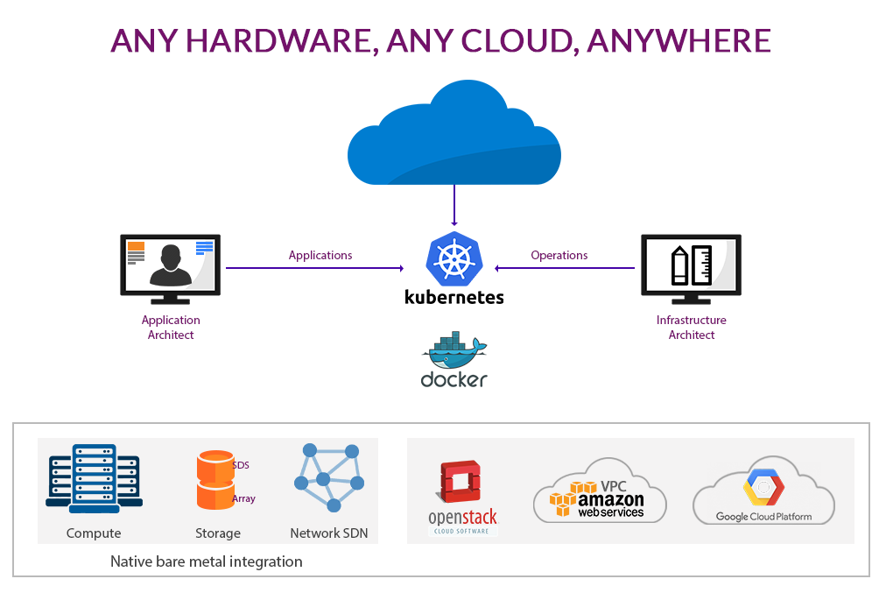
Docker Kubernetes : Cloud Infrastructure
Notes:
How to Setup Kubernetes Cluster on Google Cloud (Step by Step)
https://www.youtube.com/watch?app=desktop&v=-jLqcJUd7SU
https://www.juniper.net/assets/us/en/local/pdf/nxtwork/cloud-containers-and-microservices-with-contrail.pdf
Cluster Architecture https://kubernetes.io/docs/concepts/architecture/
https://aws.plainenglish.io/kubernetes-local-setup-using-minikube-and-kubectl-3-a46b7effe693
https://www.signadot.com/blog/beginner-minikube-guide

Slide 6
Deploying a Node App to Google Cloud with Kubernetes
Objectives
By the end of this tutorial, you should be able to:
Explain what container orchestration is and why you may need to use an orchestration tool
Discuss the pros and cons of using Kubernetes over other orchestration tools like Docker Swarm and AWS Elastic Container Service (ECS)
Explain the following Kubernetes primitives: Node, Pod, Service, Label, Deployment, Ingress, and Volume
Spin up a Node-based microservice locally with Docker Compose
Configure a Kubernetes cluster to run on Google Cloud Platform (GCP)
Set up a volume to hold Postgres data within a Kubernetes cluster
Use Kubernetes Secrets to manage sensitive information
Run Node and Postgres on Kubernetes
Expose a Node API to external users via a Load Balancer
Kubernetes cluster on Google Kubernetes Engine (GKE).
Dependencies:
Docker v20.10.10
Kubectl v1.20.8
Google Cloud SDK v365.0.1
Notes:
https://testdriven.io/blog/deploying-a-node-app-to-google-cloud-with-kubernetes/

Slide 7
Deploying a Node App to Google Cloud with Kubernetes (Con’s)
Container Orchestration?
As you move from deploying containers on a single machine to deploying them across a number of machines, you'll need an orchestration tool to manage (and automate) the arrangement, coordination, and availability of the containers across the entire system.
Orchestration tools:
Cross-server container communication
Horizontal scaling
Service discovery
Load balancing
Security/TLS
Zero-downtime deploys
Rollbacks
Logging
Monitoring
This is where Kubernetes fits in along with a number of other orchestration tools, like Docker Swarm, ECS, Mesos, and Nomad.
Which one should you use?
use Kubernetes if you need to manage large, complex clusters
use Docker Swarm if you are just getting started and/or need to manage small to medium-sized clusters
use ECS if you're already using a number of AWS services
Tool Pros Cons
Kubernetes large community, flexible, most features, hip complex setup, high learning curve, hip
Docker Swarm easy to set up, perfect for smaller clusters limited by the Docker API
ECS fully-managed service, integrated with AWS vendor lock-in
Managed Kubernetes services on the market:
Google Kubernetes Engine (GKE)
Elastic Container Service (EKS)
Azure Kubernetes Service (AKS)
Notes:
https://testdriven.io/blog/deploying-a-node-app-to-google-cloud-with-kubernetes/

Slide 8
Kubernetes Concepts
Deploying a Node App to Google Cloud with Kubernetes (Con’s)
Kubernetes API:
A Node is a worker machine provisioned to run Kubernetes. Each Node is managed by the Kubernetes master.
A Pod is a logical, tightly-coupled group of application containers that run on a Node. Containers in a Pod are deployed together and share resources (like data volumes and network addresses). Multiple Pods can run on a single Node.
A Service is a logical set of Pods that perform a similar function. It enables load balancing and service discovery. It's an abstraction layer over the Pods; Pods are meant to be ephemeral while services are much more persistent.
Deployments are used to describe the desired state of Kubernetes. They dictate how Pods are created, deployed, and replicated.
Labels are key/value pairs that are attached to resources (like Pods) which are used to organize related resources. You can think of them like CSS selectors. For example:
Environment - dev, test, prod
App version - beta, 1.2.1
Type - client, server, db
Ingress is a set of routing rules used to control the external access to Services based on the request host or path.
Volumes are used to persist data beyond the life of a container. They are especially important for stateful applications like Redis and Postgres.
A PersistentVolume defines a storage volume independent of the normal Pod-lifecycle. It's managed outside of the particular Pod that it resides in.
A PersistentVolumeClaim is a request to use the PersistentVolume by a user.
Project
https://github.com/testdrivenio/node-kubernetes
Notes:
https://testdriven.io/blog/deploying-a-node-app-to-google-cloud-with-kubernetes/
https://devopscube.com/kubernetes-architecture-explained/

Slide 9
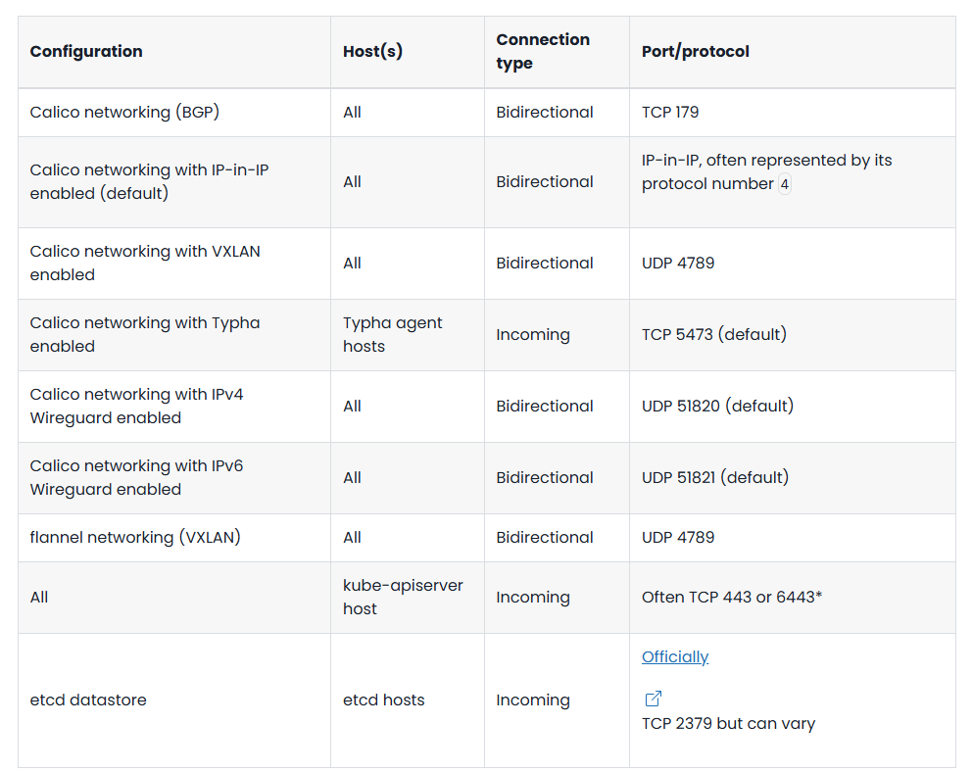
What is Google Cloud Platform (GCP) (Cons’t)
Google Cloud Platform (GCP)
Network requirements
Configuration Host(s) Connection type Port/protocol
Calico networking (BGP) All Bidirectional TCP 179
Calico networking with IP-in-IP enabled (default) All Bidirectional
IP-in-IP, often represented by its protocol number 4
Calico networking with VXLAN enabled All Bidirectional UDP 4789
Calico networking with Typha enabled Typha agent hosts Incoming TCP 5473 (default)
Calico networking with IPv4 Wireguard enabled All Bidirectional UDP 51820 (default)
Calico networking with IPv6 Wireguard enabled All Bidirectional UDP 51821 (default)
flannel networking (VXLAN) All Bidirectional UDP 4789
All kube-apiserver host Incoming Often TCP 443 or 6443*
etcd datastore etcd hosts Incoming
Officially
TCP 2379 but can vary
Notes:
https://docs.tigera.io/calico/latest/getting-started/kubernetes/requirements

Slide 10
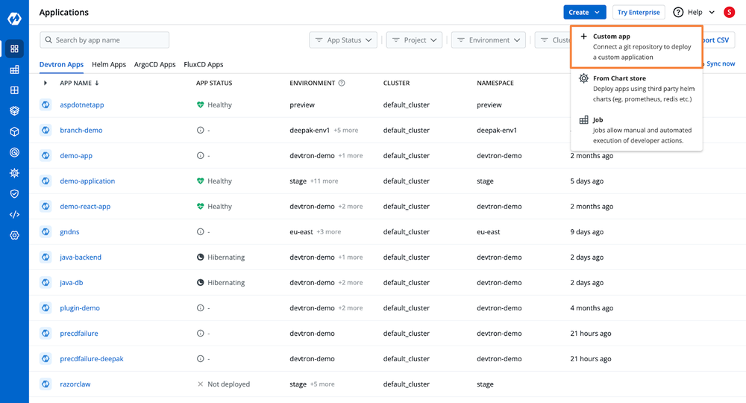
What is Google Cloud Platform (GCP)
Google Cloud Platform (GCP)
OK
Develop New Apps Faster - Tools and Modern Applications
Cloud services provided by GCP are:
Compute Engine – Virtual machines and compute resources
Cloud Storage – Scalable object storage
VPC – Private cloud networking
Cloud Logging & Monitoring – Centralized logs and metrics
Cloud Build – CI/CD pipelines
BigQuery – Serverless data warehouse
Google Kubernetes Engine (GKE) – Managed Kubernetes clusters …and much more.
Notes:
https://devtron.ai/blog/deploy-applications-on-kubernetes-gcp/

Slide 11
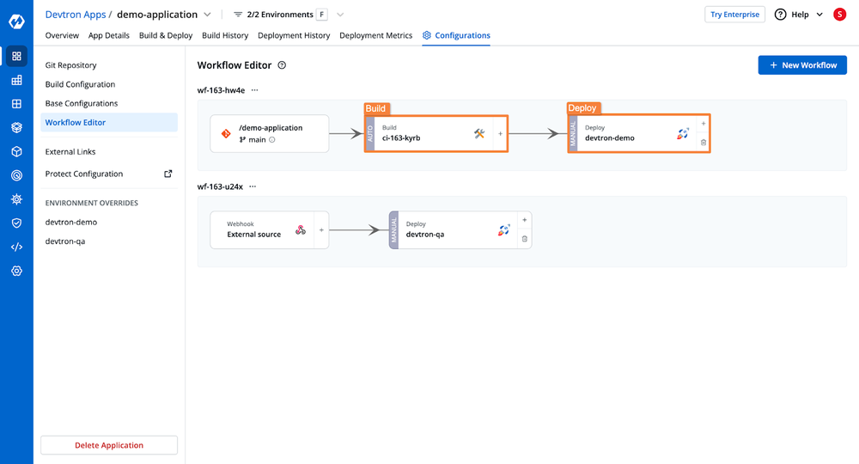
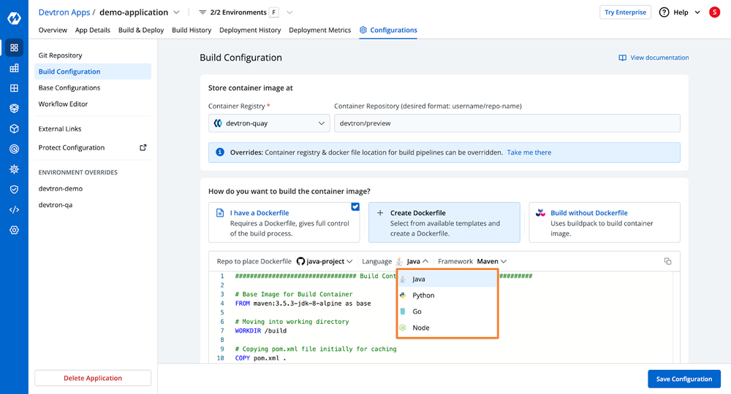
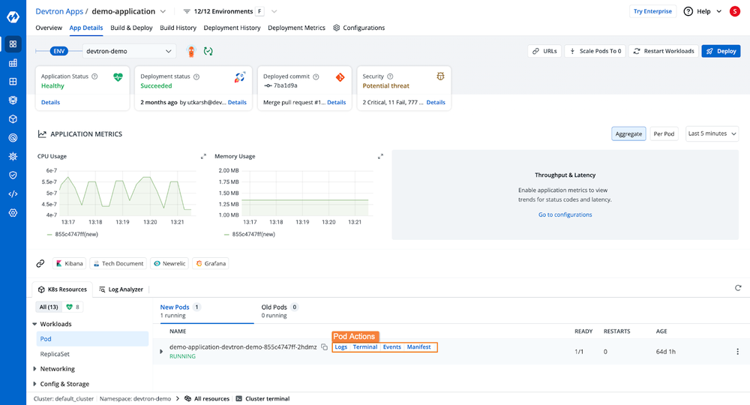
What is Google Cloud Platform (GCP) (Cons’t)
Google Cloud Platform (GCP)
Notes:
https://devtron.ai/blog/deploy-applications-on-kubernetes-gcp/

Slide 12
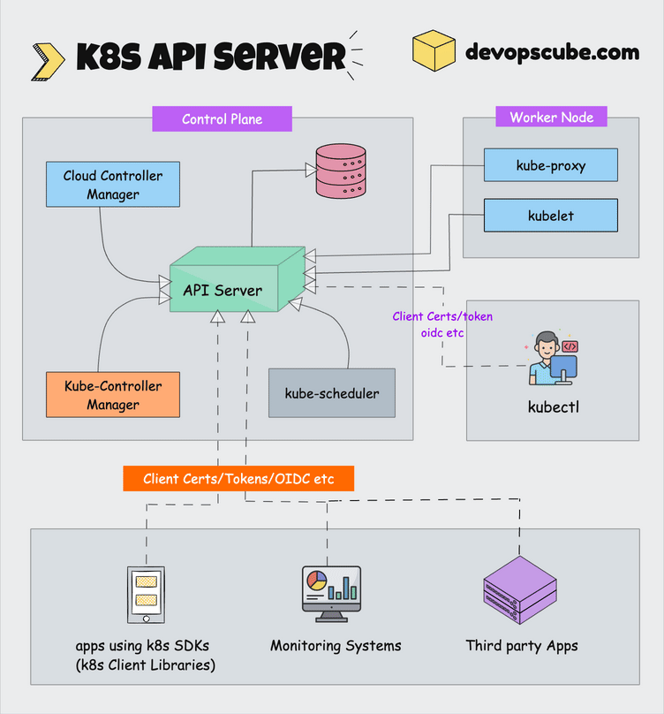
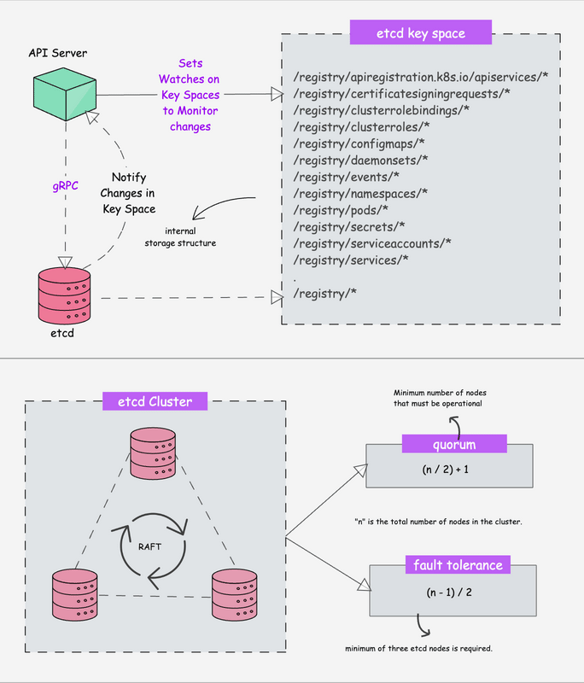
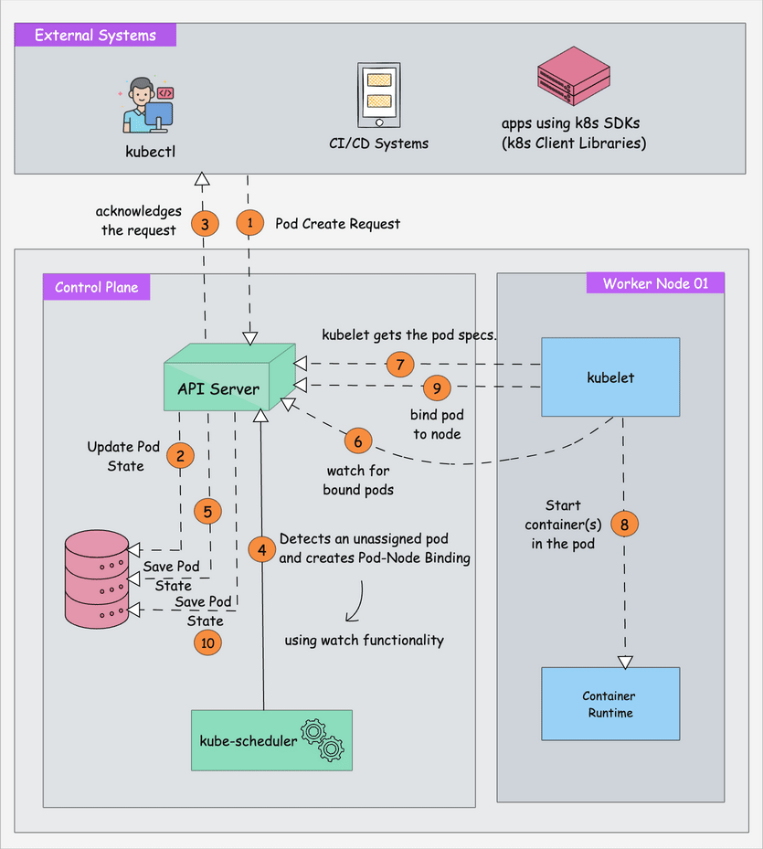
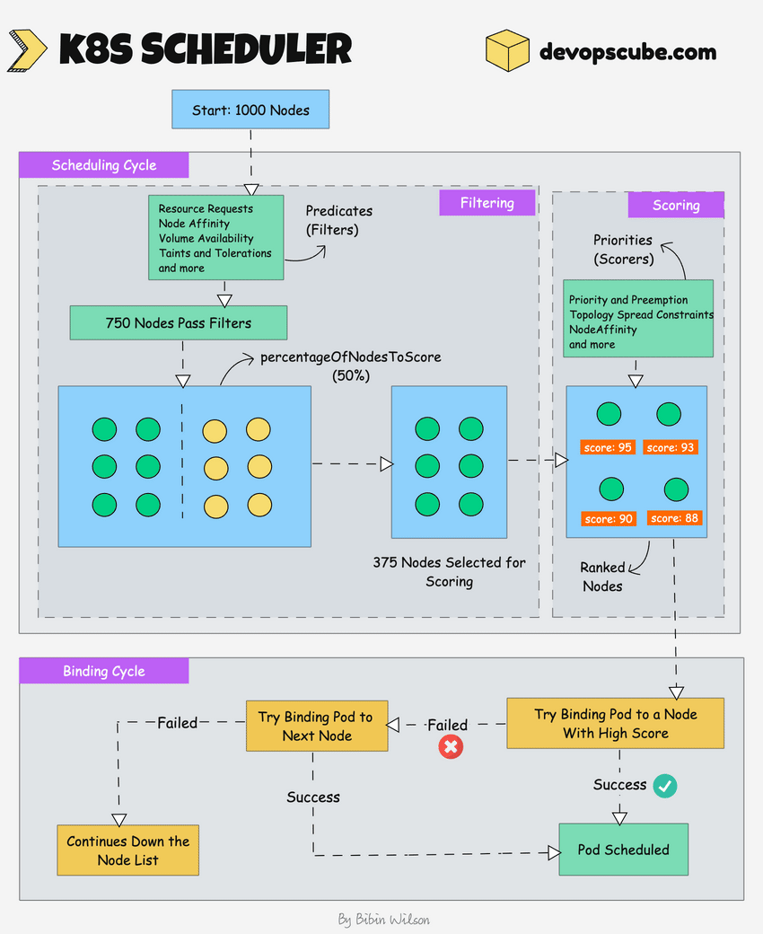
3. kube-scheduler
Google Cloud Platform (GCP)
1. kube-apiserver
2. etcd
Scheduler:
It is a controller that listens to pod creation events in the API server.
The scheduler has two phases. Scheduling cycle and the Binding cycle. Together it is called the scheduling context. The scheduling cycle selects a worker node and the binding cycle applies that change to the cluster.
The scheduler always places the high-priority pods ahead of the low-priority pods for scheduling. Also, in some cases, after the pod starts running in the selected node, the pod might get evicted or moved to other nodes. If you want to understand more, read the Kubernetes pod priority guide
You can create custom schedulers and run multiple schedulers in a cluster along with the native scheduler. When you deploy a pod you can specify the custom scheduler in the pod manifest. So the scheduling decisions will be taken based on the custom scheduler logic.
The scheduler has a pluggable scheduling framework. Meaning, that you can add your custom plugin to the scheduling workflow.
3 nodes: Can tolerate 1 node failure (quorum = 2)
5 nodes: Can tolerate 2 node failures (quorum = 3)
7 nodes: Can tolerate 3 node failures (quorum = 4)
API management: Exposes the cluster API endpoint and handles all API requests. The API is version and itsupports multiple API versions simultaneously.
Authentication (Using client certificates, bearer tokens, and HTTP Basic Authentication) and Authorization (ABAC and RBAC evaluation)
Processing API requests and validating data for the API objects like pods, services, etc. (Validation and Mutation Admission controllers)
api-server coordinates all the processes between the control plane and worker node components.
API server also contains an aggreagation layer which allows you to extend Kubernetes API to create custom APIs resources and controllers.
The only component that the kube-apiserver initiates a connection to is the etcd component. All the other components connect to the API server.
The API server also supports watching resources for changes. For example, clients can establish a watch on specific resources and receive real-time notifications when those resources are created, modified, or deleted.
Each component (Kubelet, scheduler, controllers) independently watches the API server to figure out what it needs to do.
Distributed key-value store
Strongly consistent: If an update is made to a node, strong consistency will ensure it gets updated to all the other nodes in the cluster immediately. Also if you look at CAP theorem, achieving 100% availability with strong consistency and & Partition Tolerance is impossible.
Distributed: etcd is designed to run on multiple nodes as a cluster without sacrificing consistency.
Key Value Store: A nonrelational database that stores data as keys and values. It also exposes a key-value API. The datastore is built on top of BboltDB which is a fork of BoltDB.
In a nutshell, here is what you need to know about etcd.
etcd stores all configurations, states, and metadata of Kubernetes objects (pods, secrets, daemonsets, deployments, configmaps, statefulsets, etc).
etcd allows a client to subscribe to events using Watch() API . Kubernetes api-server uses the etcd’s watch functionality to track the change in the state of an object.
etcd exposes key-value API using gRPC. Also, the gRPC gateway is a RESTful proxy that translates all the HTTP API calls into gRPC messages. This makes it an ideal database for Kubernetes.
etcd stores all objects under the /registry directory key in key-value format. For example, information on a pod named Nginx in the default namespace can be found under /registry/pods/default/nginx
Notes:
https://devopscube.com/kubernetes-architecture-explained/
https://medium.com/@platform.engineers/setting-up-kubernetes-on-cloud-platforms-2dde3c20af18
Setting Up Kubernetes on Cloud Platforms https://medium.com/@platform.engineers/setting-up-kubernetes-on-cloud-platforms-2dde3c20af18

Slide 13
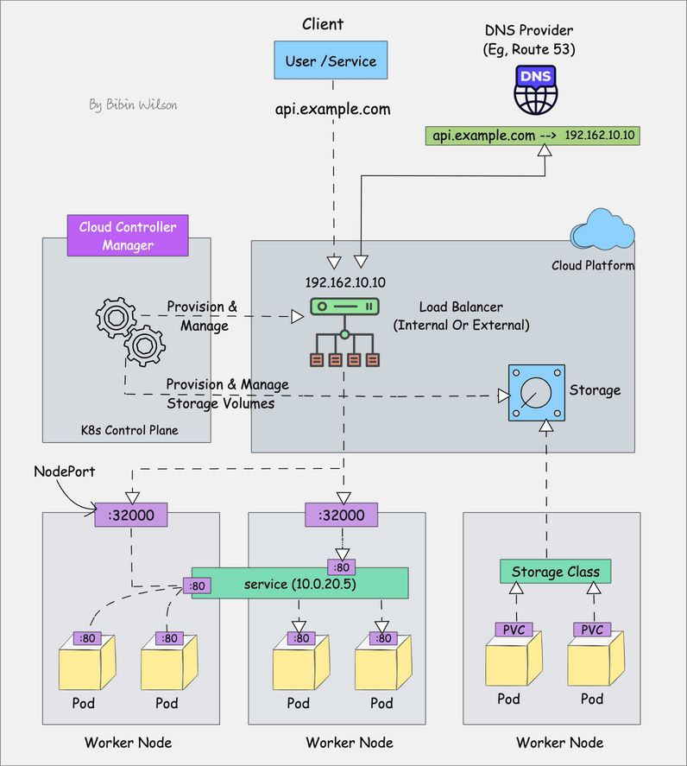
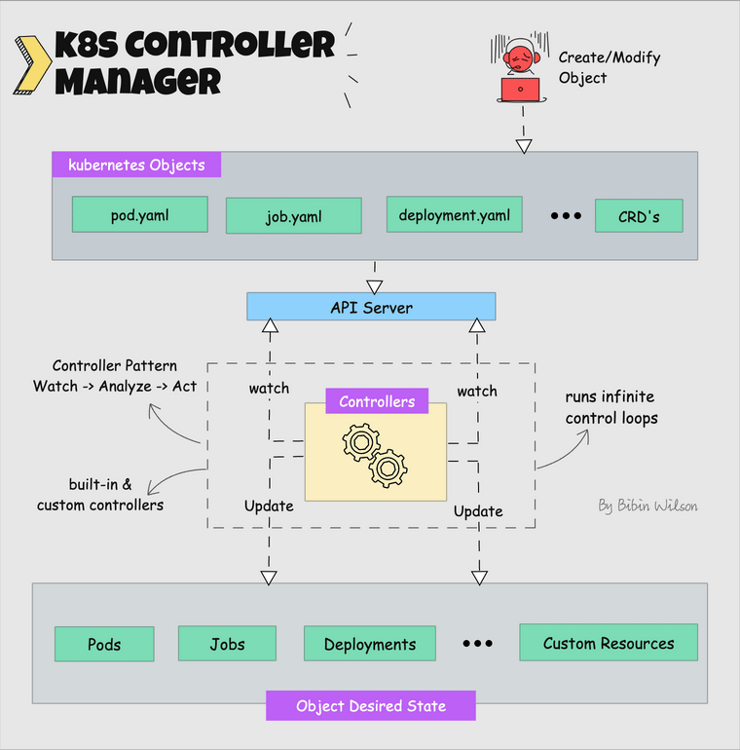
4. Kube Controller Manager
5. Cloud Controller Manager (CCM)
Google Cloud Platform (GCP)
What is a controller? Controllers are programs that run infinite control loops.
When kubernetes is deployed in cloud environments, the cloud controller manager acts as a bridge between Cloud Platform APIs and the Kubernetes cluster.
Cloud controller integration : allows Kubernetes cluster to provision cloud resources like instances (for nodes), Load Balancers (for services), and Storage Volumes (for persistent volumes).
Kubernetes controllers.
Deployment controller
Replicaset controller
DaemonSet controller
Job Controller (Kubernetes Jobs)
CronJob Controller
endpoints controller
namespace controller
service accounts controller.
Node controller
Notes:
https://devopscube.com/kubernetes-architecture-explained/
https://devopscube.com/kubernetes-architecture-explained/
A quick look at different components of a Kubernetes cluster
https://www.metricfire.com/blog/what-is-kubernetes-a-container-orchestration-platform/

Slide 14
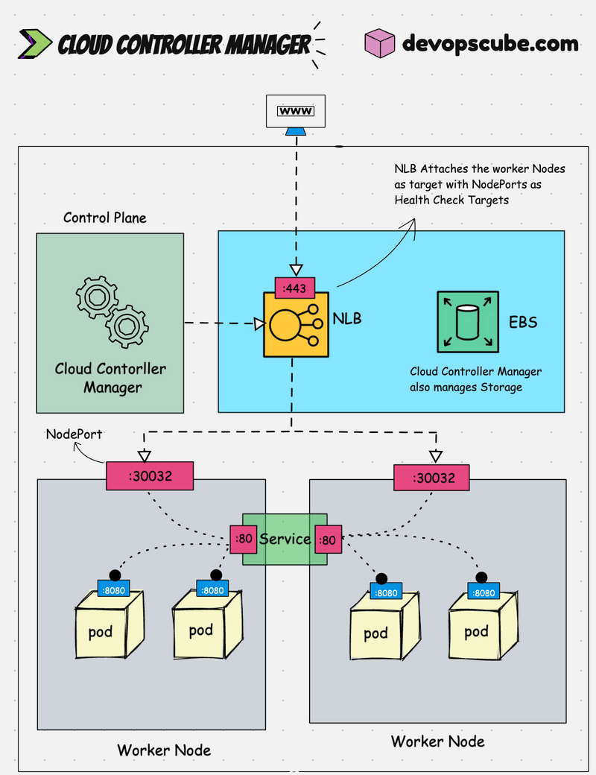
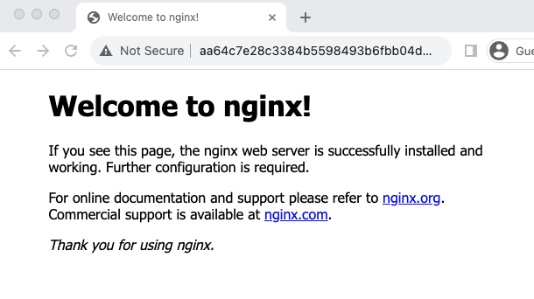
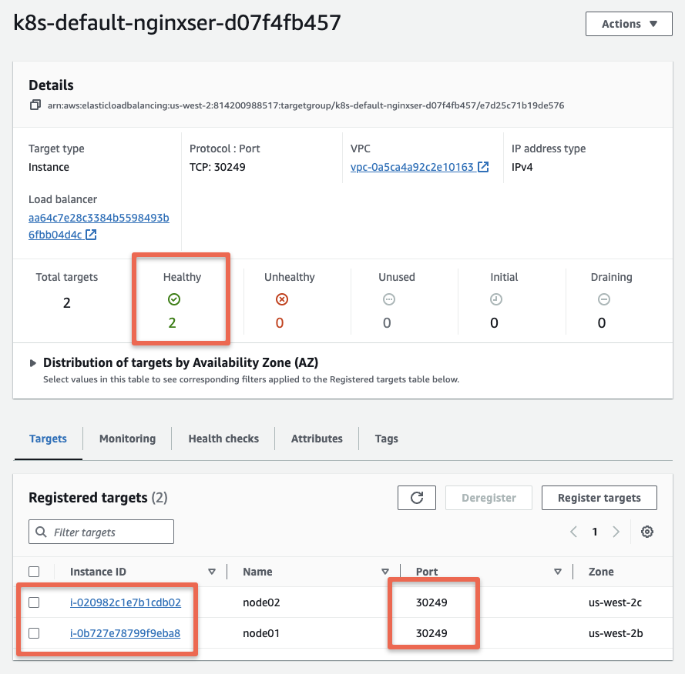
Cloud Platform for Controller Integration
Cloud Controller Manager
Google Cloud Platform (GCP)
root@ip-172-31-21-29:~# ls -l /etc/kubernetes/ ~/.kube/
/etc/kubernetes/:
total 36
-rw------- 1 root root 5648 Oct 30 05:17 admin.conf
kubectl logs -n kube-system aws-cloud-controller-manager-zwctc
Error 1: Cloud provider could not be initialized
E1028 08:39:59.394822 1 tags.go:95] Tag "KubernetesCluster" nor "kubernetes.io/cluster/..." not found; Kubernetes may behave unexpectedly.
F1028 08:39:59.394858 1 main.go:106] Cloud provid
Example 1: Cloud Platform for Controller Integration (Cont’s)
Notes:
Devopscube How to Set Up Cloud Controller Manager in AWS with Kubeadm
https://devopscube.com/aws-cloud-controller-manager/
Controllers https://kubernetes.io/docs/concepts/architecture/controller/

Slide 15
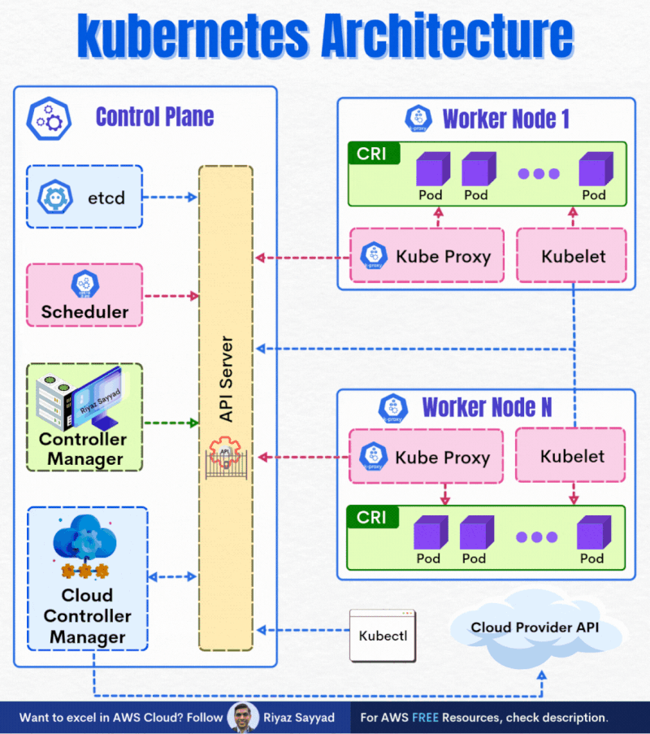
Understanding Kubernetes Cluster Architecture: 🚀 Kubernetes
Example 1: Cloud Platform for Controller Integration (Cont’s)
Google Cloud Platform (GCP)
A Kubernetes cluster consists of control plane nodes and worker nodes.
Control Plane
The control plane is responsible for container orchestration and maintaining the desired state of the cluster. It has the following components.
kube-apiserver
etcd
kube-scheduler
kube-controller-manager
cloud-controller-manager
A cluster can have one or more control plane nodes.
Worker Node
The Worker nodes are responsible for running containerized applications. The worker Node has the following components.
kubelet
kube-proxy
Container runtime
Notes:
https://www.linkedin.com/posts/riyazsayyad_understanding-kubernetes-architecture-activity-7246470560715530241-n7rV
https://devopscube.com/kubernetes-architecture-explained/
https://kubernetes.io/docs/concepts/architecture/cloud-controller/

Slide 16
Example 1: Cloud Platform for Controller Integration (Cont’s)
Google Cloud Platform (GCP)
Specific components (nodes, Loadbalancers, storage, etc).

Slide 17
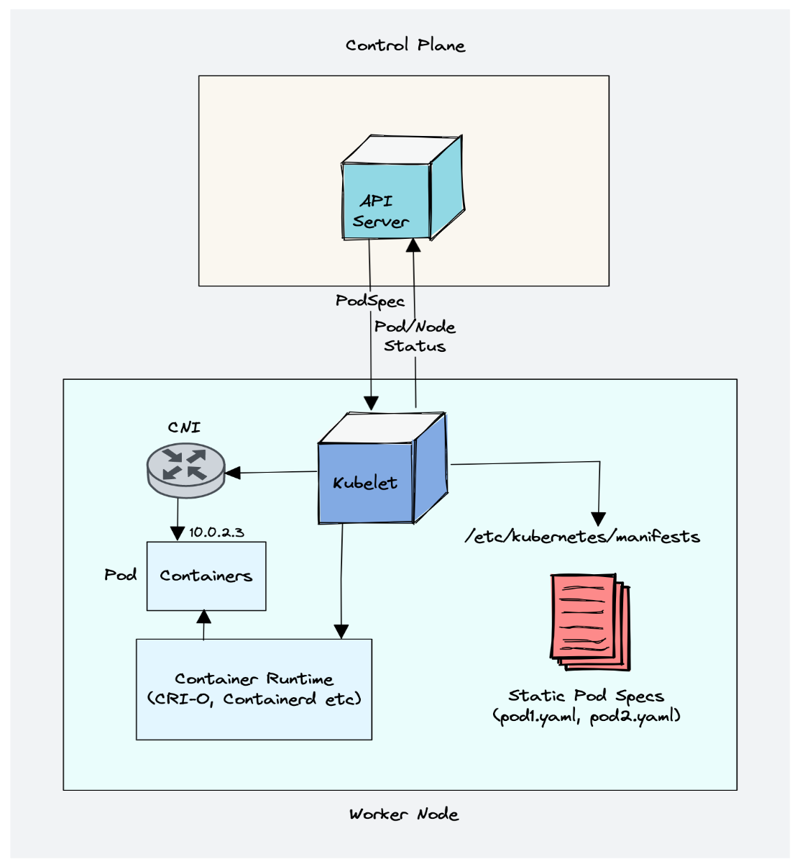
Example 1: Cloud Platform for Controller Integration (Cont’s)
Creating, modifying, and deleting containers for the pod.
Responsible for handling liveliness, readiness, and startup probes.
Responsible for Mounting volumes by reading pod configuration and creating respective directories on the host for the volume mount.
Collecting and reporting Node and pod status via calls to the API server with implementations like cAdvisor and CRI.
Google Cloud Platform (GCP)
The cloud controller manager:
Node controller: This controller updates node-related information by talking to the cloud provider API. For example, node labeling & annotation, getting hostname, CPU & memory availability, nodes health, etc.
Route controller: It is responsible for configuring networking routes on a cloud platform. So that pods in different nodes can talk to each other.
Service controller: It takes care of deploying load balancers for kubernetes services, assigning IP addresses, etc.
Example:
Deploying Kubernetes Service of type Load balancer. Here Kubernetes provisions a Cloud-specific Loadbalancer and integrates with Kubernetes Service.
Provisioning storage volumes (PV) for pods backed by cloud storage solutions.
1. Kubelet
Creating, modifying, and deleting containers for the pod.
Responsible for handling liveliness, readiness, and startup probes.
Responsible for Mounting volumes by reading pod configuration and creating respective directories on the host for the volume mount.
Collecting and reporting Node and pod status via calls to the API server with implementations like cAdvisor and CRI.
Kubelet uses the CRI (container runtime interface) gRPC interface to talk to the container runtime.
It also exposes an HTTP endpoint to stream logs and provides exec sessions for clients.
Uses the CSI (container storage interface) gRPC to configure block volumes.
It uses the CNI plugin configured in the cluster to allocate the pod IP address and set up any necessary network routes and firewall rules for the pod.

Slide 18
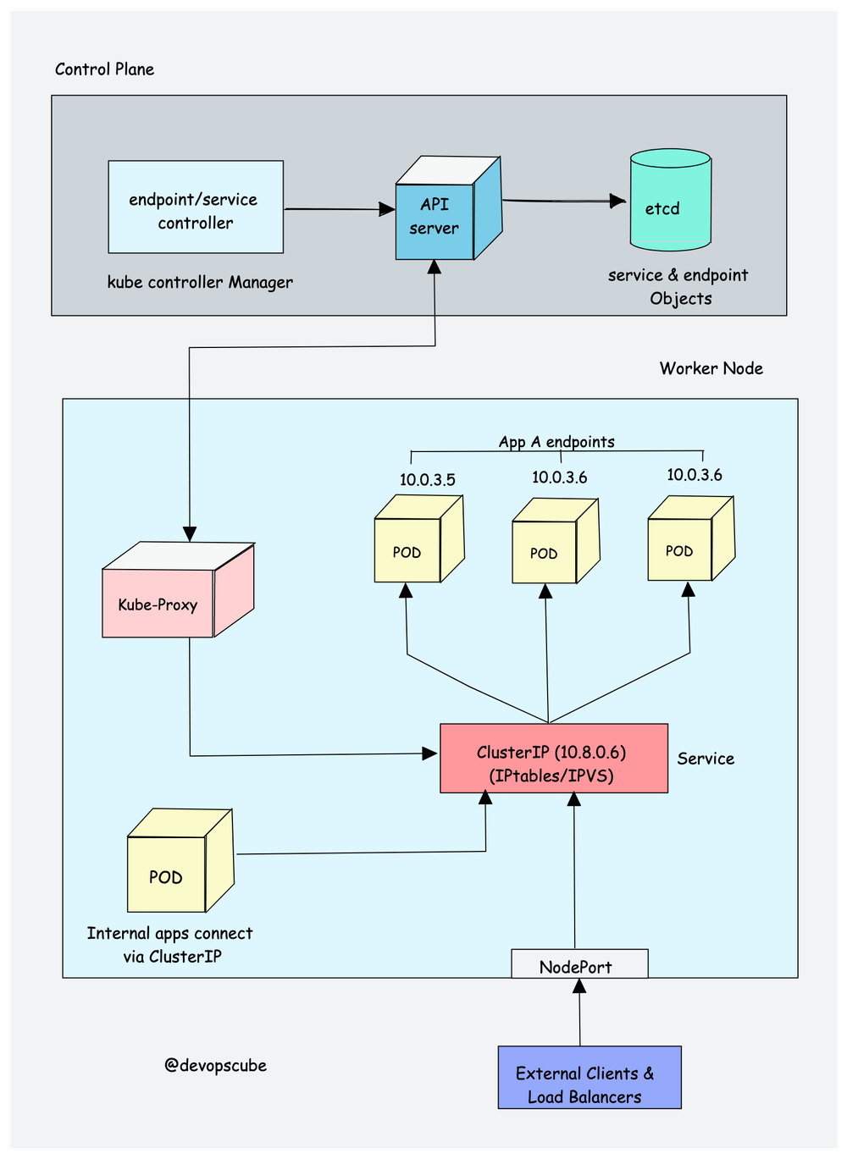
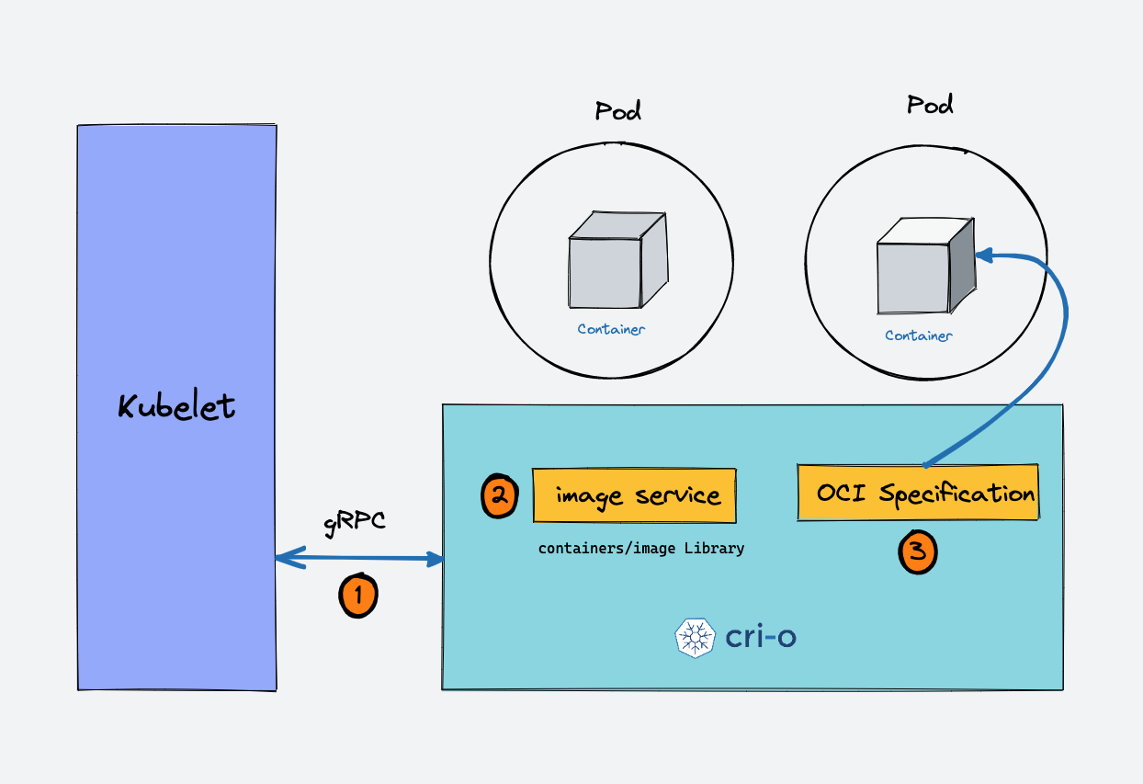
Example1 : Cloud Platform for Controller Integration (Cont’s)
Google Cloud Platform (GCP)
2. Kube proxy
3. Container Runtime
CRI-O daemon to launch the required containers via Kubernetes Container Runtime Interface.
Two key concepts:
Container Runtime Interface (CRI): It is a set of APIs that allows Kubernetes to interact with different container runtimes. It allows different container runtimes to be used interchangeably with Kubernetes. The CRI defines the API for creating, starting, stopping, and deleting containers, as well as for managing images and container networks.
Open Container Initiative (OCI): It is a set of standards for container formats and runtimes
IPTables, NFTables, IPVS, Userspace, Kernelspace

Slide 19
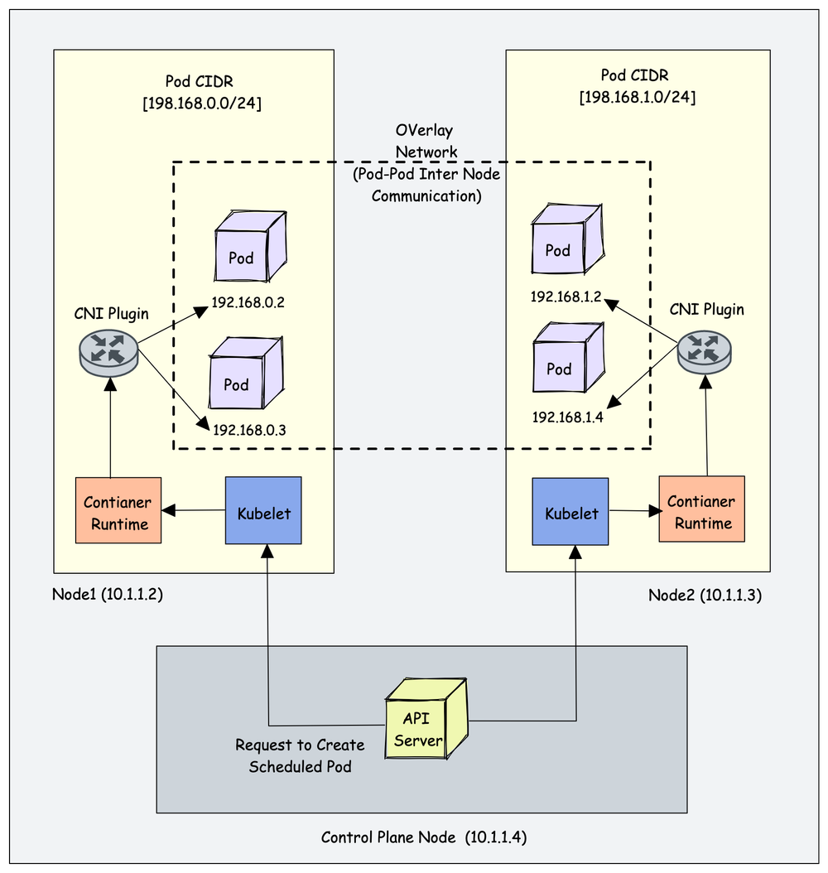
Example 1: Cloud Platform for Controller Integration (Cont’s)
Google Cloud Platform (GCP)
Kubernetes Cluster Addon Components:
CNI Plugin (Container Network Interface)
CoreDNS (For DNS server): CoreDNS acts as a DNS server within the Kubernetes cluster. By enabling this addon, you can enable DNS-based service discovery.
Metrics Server (For Resource Metrics): This addon helps you collect performance data and resource usage of Nodes and pods in the cluster.
Web UI (Kubernetes Dashboard): This addon enables the Kubernetes dashboard to manage the object via web UI.
1. CNI Plugin
Container Networking Interface (CNI)
Kubernetes Native Objects:
Pod
Namespaces
Replicaset
Deployment
Daemonset
Statefulset
Jobs & Cronjobs
ConfigMaps and Secrets
Kubernetes Objects plays a key role:
Services
Ingress
Network policies.
Next ……
Google Compute Engine (GCE)
CNI plugins include:
Calico
Flannel
Weave Net
Cilium (Uses eBPF)
Amazon VPC CNI (For AWS VPC)
Azure CNI (For Azure Virtual network)Kubernetes networking is a big topic and it differs based on the hosting platforms.

Slide 20
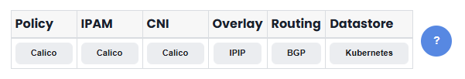
Example 1: Cloud Platform for Controller Integration (Cont’s) Self-managed Kubernetes in Google Compute Engine (GCE) (Cont’s)
Google Cloud Platform (GCP)
Google Compute Engine (GCE)
Self-managed Kubernetes in Google Compute Engine (GCE) (Cont’s)
A. Environment:
kubeadm for Calico networking and network policy
Other tools and options
B. Dedicated virtual private network (VPC).
C. dedicated infrastructure management tool like Terraform for managing cloud resources.
Create the VPC.
gcloud compute networks create example-k8s --subnet-mode custom
Create the k8s-nodes subnet in the example-k8s VPC network:
gcloud compute networks subnets create k8s-nodes \
--network example-k8s \
--range 10.240.0.0/24
Create a firewall rule that allows internal communication across TCP, UDP, ICMP and IP in IP (used for the Calico overlay):
gcloud compute firewall-rules create example-k8s-allow-internal \
--allow tcp,udp,icmp,ipip \
--network example-k8s \
--source-ranges 10.240.0.0/24
Create a firewall rule that allows external SSH, ICMP, and HTTPS:
gcloud compute firewall-rules create example-k8s-allow-external \
--allow tcp:22,tcp:6443,icmp \
--network example-k8s \
--source-ranges 0.0.0.0/0
Create the controller VM.
gcloud compute instances create controller \
--async \
--boot-disk-size 200GB \
--can-ip-forward \
--image-family ubuntu-2204-lts \
--image-project ubuntu-os-cloud \
--machine-type n1-standard-2 \
--private-network-ip 10.240.0.11 \
--scopes compute-rw,storage-ro,service-management,service-control,logging-write,monitoring \
--subnet k8s-nodes \
--zone us-central1-f \
--tags example-k8s,controller
Create three worker VMs.
for i in 0 1 2; do
gcloud compute instances create worker-${i} \
--async \
--boot-disk-size 200GB \
--can-ip-forward \
--image-family ubuntu-2204-lts \
--image-project ubuntu-os-cloud \
--machine-type n1-standard-2 \
--private-network-ip 10.240.0.2${i} \
--scopes compute-rw,storage-ro,service-management,service-control,logging-write,monitoring \
--subnet k8s-nodes \
--zone us-central1-f \
--tags example-k8s,worker
done
Install Docker on the controller VM and each worker VM. On each VM run:
sudo apt update
sudo apt install -y docker.io
sudo systemctl enable docker.service
sudo apt install -y apt-transport-https curl
Install Kubernetes and create the cluster
Install kubeadm, kubelet, and kubectl on each worker node and the controller node (see kubeadm docs for more details).
Connect to each node and run these commands:
curl -fsSL https://dl.k8s.io/apt/doc/apt-key.gpg | sudo apt-key add -
cat <<EOF | sudo tee /etc/apt/sources.list.d/kubernetes.list
deb https://pkgs.k8s.io/ kubernetes-xenial main
EOF
sudo apt-get update
sudo apt-get install -y kubelet kubeadm kubectl
sudo apt-mark hold kubelet kubeadm kubectl
Create the controller node of a new cluster.
Connect to the controller VM, and run the following command:
sudo kubeadm init --pod-network-cidr 192.168.0.0/16
note
The final line of the kubeadm init output contains the command for joining your workers to the controller. Make a note of the command, which needs to be used in a later step.
The command looks something similar to this:
kubeadm join 10.240.0.11:6443 --token ar77y2.7274jxuumt8vhhvw \
--discovery-token-ca-cert-hash sha256:d913182b646660c7be5bd76c1b9e9fa3e613ed9c18ef36ad0d475f8f7c887331
Set up kubectl for the Ubuntu user.
Connect to the controller VM, and run the following commands:
mkdir -p $HOME/.kube
sudo cp -i /etc/kubernetes/admin.conf $HOME/.kube/config
sudo chown $(id -u):$(id -g) $HOME/.kube/config
Join your worker nodes to the controller node.
note
Use the command that you copied in the earlier step.
Run this on each worker, prepending sudo to run it as root. It will look something like this:
sudo kubeadm join 10.240.0.11:6443 --token <token> --discovery-token-ca-cert-hash sha256:<hash>
Verify that all nodes have joined.
Run this command on the controller node.
kubectl get nodes
which should output something similar to:
NAME STATUS ROLES AGE VERSION
controller NotReady master 5m49s v1.17.2
worker-0 NotReady <none> 3m38s v1.17.2
worker-1 NotReady <none> 3m7s v1.17.2
worker-2 NotReady <none> 5s v1.17.2
Install Calico
On the controller, install the Tigera Operator and custom resource definitions:
kubectl create -f https://raw.githubusercontent.com/projectcalico/calico/v3.30.3/manifests/operator-crds.yaml
kubectl create -f https://raw.githubusercontent.com/projectcalico/calico/v3.30.3/manifests/tigera-operator.yaml
Download the custom resources necessary to configure Calico
curl https://raw.githubusercontent.com/projectcalico/calico/v3.30.3/manifests/custom-resources.yaml -O
If you wish to customize the Calico install, customize the downloaded custom-resources.yaml manifest. Then create the manifest to install Calico.
kubectl create -f custom-resources.yaml
Notes:
Self-managed Kubernetes in Google Compute Engine (GCE)
https://docs.tigera.io/calico/latest/getting-started/kubernetes/self-managed-public-cloud/gce
https://docs.tigera.io/calico/latest/getting-started/kubernetes/self-managed-public-cloud/gce
https://docs.tigera.io/calico/latest/getting-started/kubernetes/self-managed-public-cloud/gce#big-picture

Slide 21
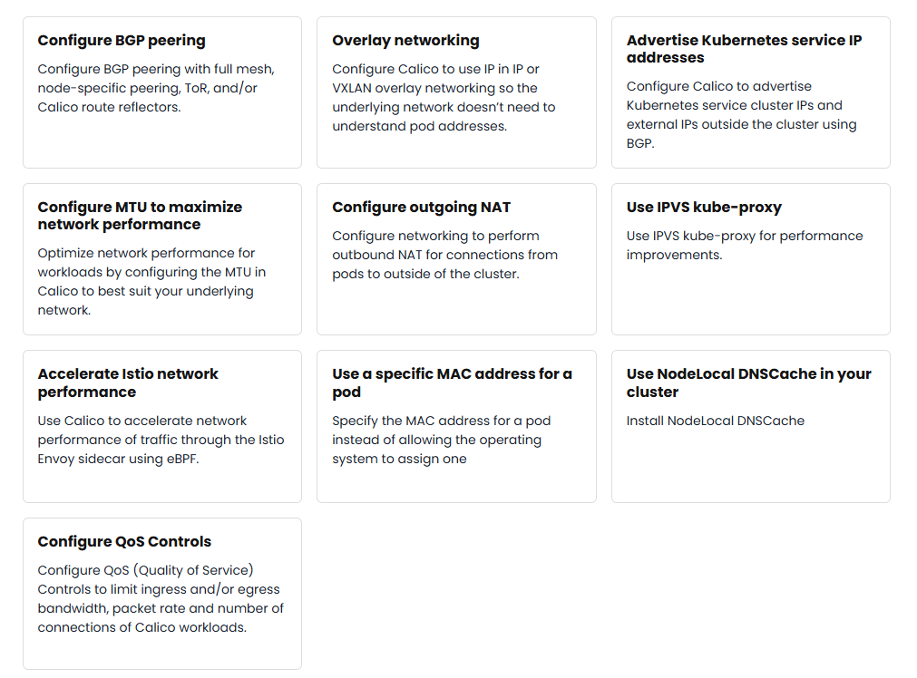
Example 1: Cloud Platform for Controller Integration (Cont’s) Kubernetes in Google Network Engine (GNE) (Cont’s)
Google Cloud Platform (GCP)
Google Compute Engine (GCE)
Google Network Egine (GNE)
Kubernetes in Google Network Engine (GNE) (Cont’s)
Configuring Networking
Networking
Configuring networking
IP address management
Networking for : openstack,….
Notes:
https://docs.tigera.io/calico/latest/networking/
Cluster Networking https://kubernetes.io/docs/concepts/cluster-administration/networking/
Kubernetes Networking https://spacelift.io/blog/kubernetes-networking
Services, Load Balancing, and Networking https://kubernetes.io/docs/concepts/services-networking/
Self-managed Kubernetes in Google Compute Engine (GCE)
https://docs.tigera.io/calico/latest/getting-started/kubernetes/self-managed-public-cloud/gce
https://docs.tigera.io/calico/latest/getting-started/kubernetes/self-managed-public-cloud/gce
https://docs.tigera.io/calico/latest/getting-started/kubernetes/self-managed-public-cloud/gce#big-picture

Slide 22
Example 1: Cloud Platform for Controller Integration (Cont’s) Kubernetes for Network Node (Cont’s)
Google Cloud Platform (GCP)
Google Compute Engine (GCE)
Google Network Egine (GNE)
Kubernetes in Google Network Engine (GNE) (Cont’s)
Notes:
https://www.inovex.de/de/blog/kubernetes-networking-part-1-en/
https://kubernetes.io/blog/2021/12/22/kubernetes-in-kubernetes-and-pxe-bootable-server-farm/

Slide 23
Example 1: Cloud Platform for Storage (Cont’s)
Google Cloud Platform (GCP)
Storage:
Volumes
Persistent Volumes
Projected Volumes
Ephemeral Volumes
Storage Classes
Volume Attributes Classes
Dynamic Volume Provisioning
Volume Snapshots
Volume Snapshot Classes
CSI Volume Cloning
Storage Capacity
Node-specific Volume Limits
Volume Health Monitoring
Windows Storage
Next ……
Google Compute Engine (GCE)
Notes:
Memasang bucket Cloud Storage sebagai volume persisten
https://cloud.google.com/kubernetes-engine/docs/how-to/cloud-storage-fuse-csi-driver-pv?hl=id
https://www.baeldung.com/ops/kubernetes-node-storage-allocation
https://kubernetes.io/docs/concepts/storage/

Slide 24
Example 1: Cloud Platform for Storage (Cont’s)
Google Cloud Platform (GCP)
Storage:
Volumes
Persistent Volumes
Projected Volumes
Ephemeral Volumes
Storage Classes
Volume Attributes Classes
Dynamic Volume Provisioning
Volume Snapshots
Volume Snapshot Classes
CSI Volume Cloning
Storage Capacity
Node-specific Volume Limits
Volume Health Monitoring
Windows Storage
Notes:
Compute, Storage, and Networking Extensions https://kubernetes.io/docs/concepts/extend-kubernetes/compute-storage-net/
Kubernetes Storage
Memasang bucket Cloud Storage sebagai volume persisten
https://cloud.google.com/kubernetes-engine/docs/how-to/cloud-storage-fuse-csi-driver-pv?hl=id
https://www.baeldung.com/ops/kubernetes-node-storage-allocation
https://kubernetes.io/docs/concepts/storage/

Slide 25
Example 1: Cloud Platform for Compute (Cont’s)
Google Cloud Platform (GCP)
Notes:
Manage compute resources
https://www.elastic.co/docs/deploy-manage/deploy/cloud-on-k8s/manage-compute-resources

Slide 26
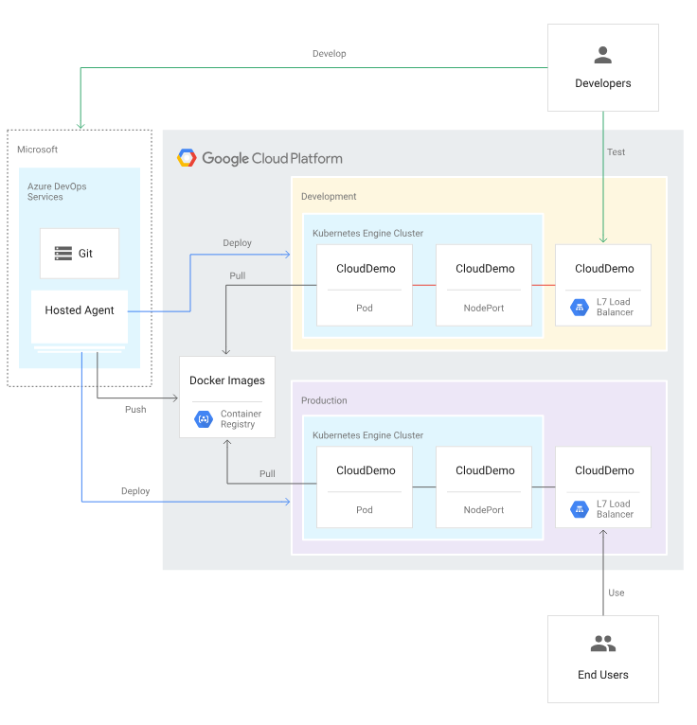
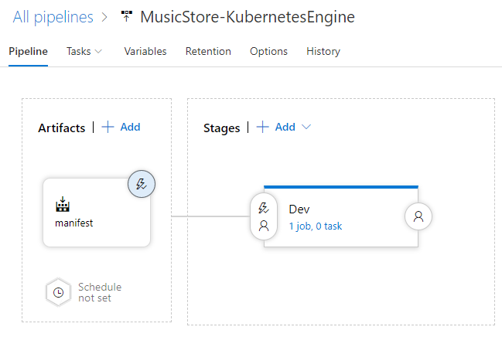
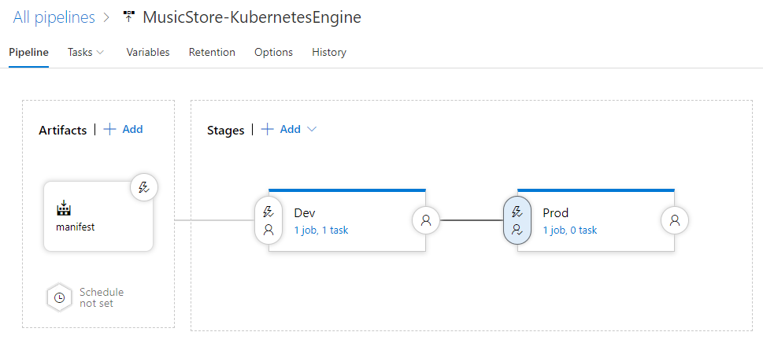
Creating a CI/CD pipeline with Azure Pipelines and Google Kubernetes Engine https://cloud.google.com/dotnet/docs/creating-cicd-pipeline-vsts-kubernetes-engine
https://cloud.google.com/compute
Google Cloud Platform (GCP)
Creating an Azure DevOps project:
Go to the Azure DevOps home page (https://dev.azure.com/YOUR_AZURE_DEVOPS_ACCOUNT_NAME).
Click New Project.
Enter a project name, such as CloudDemo.
Set Visibility to Private, and then click Create.
After you create the project, in the menu on the left, click Repos.
Click Import to fork the dotnet-docs-samples repository from GitHub, and then set the following values:
Repository type: Git
Clone URL: https://github.com/GoogleCloudPlatform/dotnet-docs-samples.git
Click Import.
When the import process is done, you see the source code of the dotnet-docs-samples repository.
GKE
Cloud Load Balancing
Cloud Storage (for Container Registry)
Notes:
https://cloud.google.com/dotnet/docs/creating-cicd-pipeline-vsts-kubernetes-engine
https://cloud.google.com/build/docs/deploy-containerized-application-cloud-run?hl=id
1. Pod Management: Probes, Init Containers, and Startup Tasks
1.1 Liveness and Readiness Probes
https://engineering.teknasyon.com/advanced-kubernetes-management-for-devops-teams-a-comprehensive-guide-5c31beeeb274

Slide 27
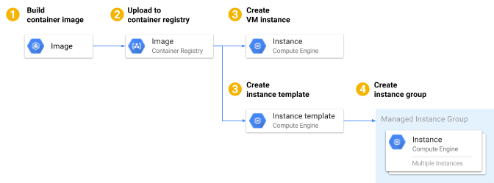
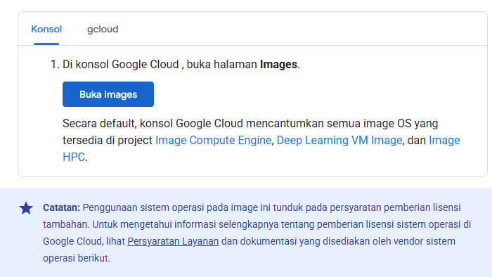
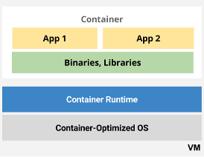
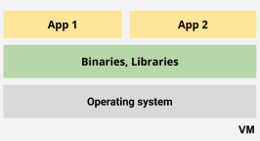
Container di Compute Engine https://cloud.google.com/compute/docs/containers?hl=id
https://cloud.google.com/compute
Google Cloud Platform (GCP)
Container software adalah cara yang mudah untuk menjalankan aplikasi Anda di beberapa instance ruang pengguna yang terisolasi. Anda dapat menjalankan container di image VM publik Linux atau Windows Server, atau pada image Container-Optimized OS. Container memungkinkan aplikasi Anda berjalan dengan lebih sedikit dependensi di virtual machine (VM) host dan berjalan secara terpisah dari aplikasi dalam container lainnya yang Anda deploy ke instance VM yang sama. Karakteristik ini membuat aplikasi dalam container lebih portabel, lebih mudah di-deploy, dan lebih mudah dikelola dalam skala besa
Notes:
https://cloud.google.com/compute/docs/containers/deploying-containers?hl=id
https://cloud.google.com/kubernetes-engine/docs/tutorials/hello-app?hl=id
:How to start Kubernetes cluster on Docker Desktop in three steps
https://cloud.google.com/kubernetes-engine/docs/how-to/cluster-access-for-kubectl?hl=id
https://www.docker.com/blog/building-certified-kubernetes-cluster-on-premises-with-docker/
https://www.docker.com/blog/how-to-set-up-a-kubernetes-cluster-on-docker-desktop/

Slide 28
Cloud Platform for Compute Integration
Google Cloud Platform (GCP)
Example 2: Cloud Platform for Compute Integration (Cont’s)

Slide 29
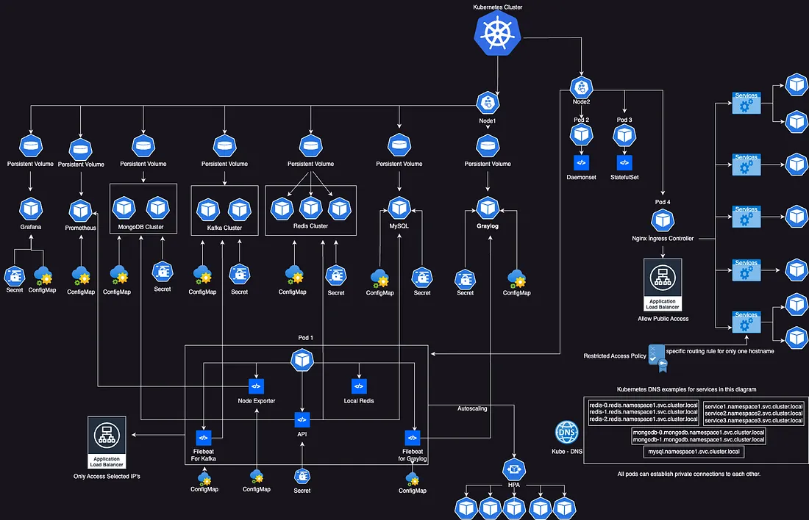
Management for DevOp
OK
Notes:
https://engineering.teknasyon.com/advanced-kubernetes-management-for-devops-teams-a-comprehensive-guide-5c31beeeb274

Slide 30
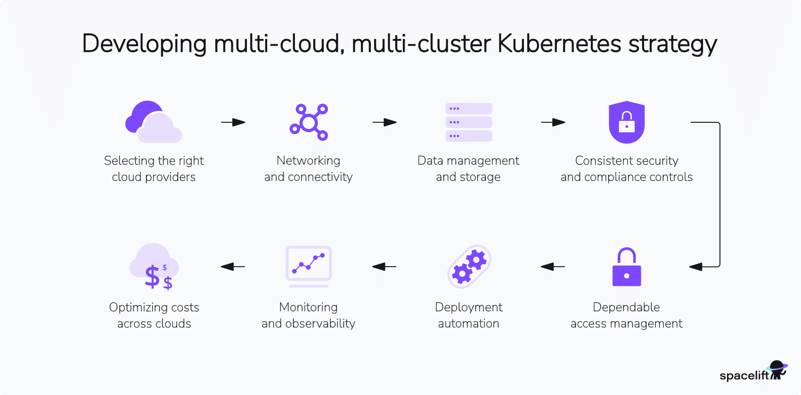
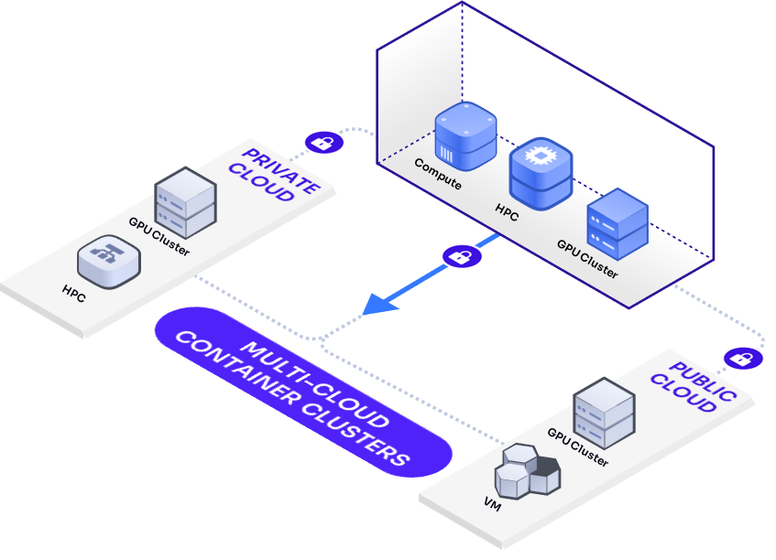
Multi-cloud architecture across heterogeneous clouds (Cont’s)
Multicluster-cloud Container for Compute Nodes architecture
Kubernetes Multi-Cloud Multi-Cluster
Multi-cloud Container Clusters (MCC)
Notes:
https://xrcloud.ai/products-multi-cloud-container-clusters/
Kubernetes Multi-Cloud Multi-Cluster https://spacelift.io/blog/kubernetes-multi-cloud

Slide 31
Multi-Node Lab
Multi Nodes-cloud architecture using kubernetes, Docker (compute, controller, networking and storage)
Multi Nodes-cloud architecture using kubernetes, Docker (Cont’s)
Multicluster-cloud Container for Compute Nodes architecture
Notes:
Multi-Node Lab - DevStack
Install and configure the controller node
Distributed compute node and storage deployment

Slide 32
Example: Cloud Platform for Controller Integration (Cont’s)
Container Compute node on cloud infrastructure
Container Controller node on cloud infrastructure
Container Networking node on cloud infrastructure
Container Storage (image) node on cloud infrastructure
Docker, kubernetes Container Nodes for Compute node, controller node, networking node and storage node
Container Compute Service (ACS)
what is compute node in kubernetes Docker

Slide 33
Thank you.
Q&A

